Slide 1

Data correction techniques produce better datasets and more reproducible results
Notes:
IST POLL
Thanks so much for the introduction and a Good Day to all!
I am thrilled to be here to talk about one of my favorite subjects, namely variances in metabolomics mass spec data and how they can be corrected.
The two largest sources of variation stem from #1 the ion source and instrumental introduced errors, and the second from variable sample input and matrix inherent sample-to-sample variation.
Ion suppression is a major contributor to challenges in standardization across labs and analytical conditions. It is always been the elephant in the room that no one wants to admit they see. This suppressed signal can be caused by co-eluting interferences, sample matrix, ion source, chromatographic conditions and many other factors.
In addition to accounting for ion-suppression, we also need to accurately represent the total metabolite amounts in each sample, namely normalize the samples.
While there are many statistical methods that can be used for handling unwanted variation in metabolomics data, instead of messaging the data, I will show you how to actually correct for these variances using a Workflow.

Slide 2

Sources of Error
1. Suppression losses: These are significant losses of signal due to co-eluting interferences, biological matrices, sample injection, contaminants, chromatographic conditions, ion sources, etc.
2. Normalization variances: These are significant variations in very small samples and their preparations, including sample size, variable tissue types, or dilutions, losses during sample preparation and other batch effects.
Notes:
Note differences: suppression is always a loss of signal for an individual datapoint and is corrected for the datapoint, while Normalization is actually a variance around a median value. Its correction is applied to the entire sample.

Slide 3

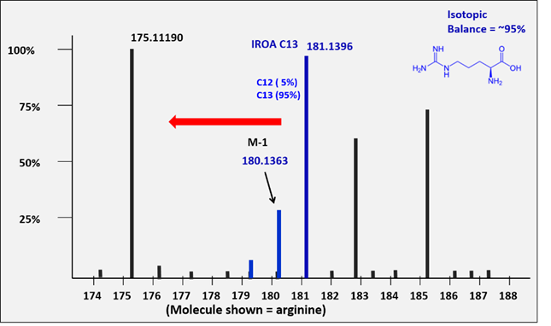
What is IROA?
The IROA (Isotopic Ratio Outlier Analysis) protocols embed specific chemical characteristics into the mass spectral data stream in the form of mathematically definable isotopic patterns based on the universal and random distribution of 95% ¹³C isotopes.
This information is used to retrieve higher quality data, with reduced error, and lowest possible experimental variance when the IROA peak is a constant or Internal Standard.
Phenotypic IROA peak ->
Notes:
The IROA protocols use stable-isotopes to embed unique chemical signatures into mass spectral data that are mathematically definable and easily found using software algorithms. How is this done? I will take you through a simple exercise illustrating how we use isotopic patterns.

Slide 4

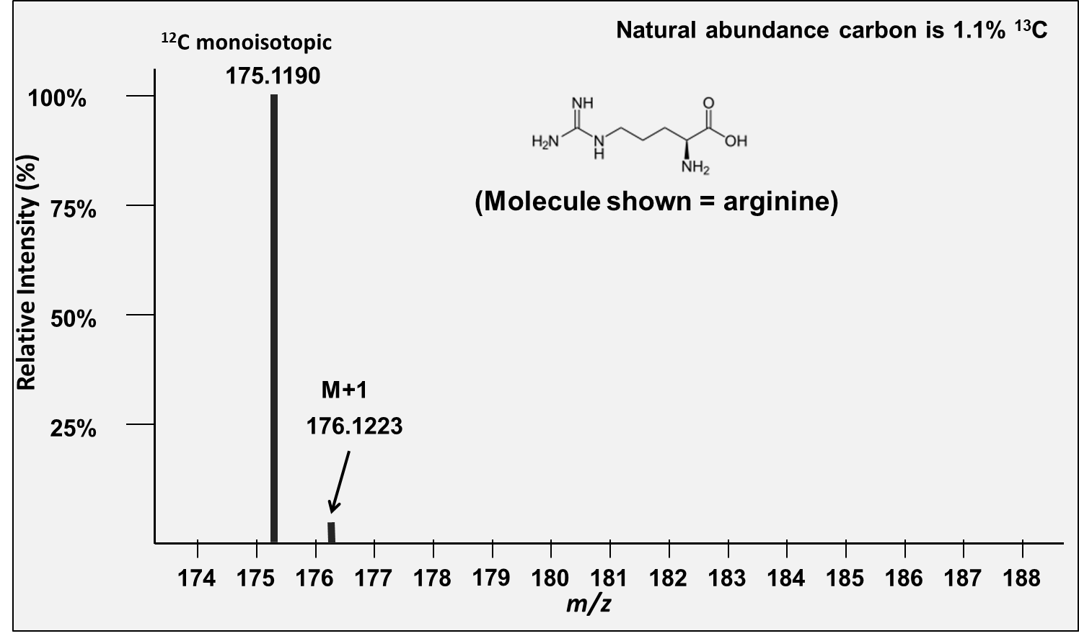
Isotopic Patterns
Arginine has 6 Carbons
6.6% (6 x 1.1) molecules will contain one (1) ¹³ C to every 93.4 (which will contain only ¹²C)
Peak height of the M+1 peak as a percentage of the peak height of the M+ peak 6.6/93.4 = 7%
Notes:
OK, so let’s talk about isotopic patterns. We know that the natural abundance of carbon 13 is approx. 1.1%. For a 6-carbon molecule, like arginine, shown here, there is a small M+1 peak, which is roughly 6% of it’s monoisotopic peak.
The M+1 peak is so small that it is easily lost in spectral noise and is not very useful for compound identification.

Slide 5
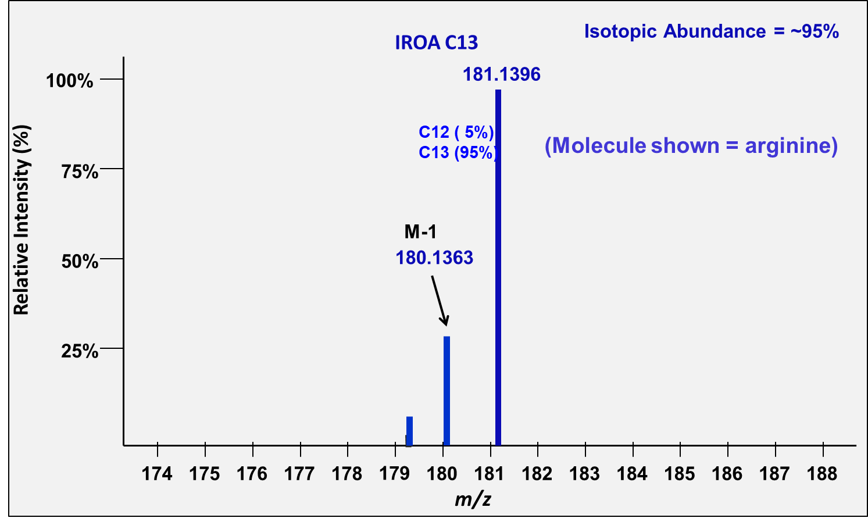
The IS (internal Standard)
¹³C 95% -labeled, 600-1000 unique
Compounds
Notes:
The second standard that we use in the workflow is the internal standard - this is the set of compounds that are labeled with C13 95%

Slide 6
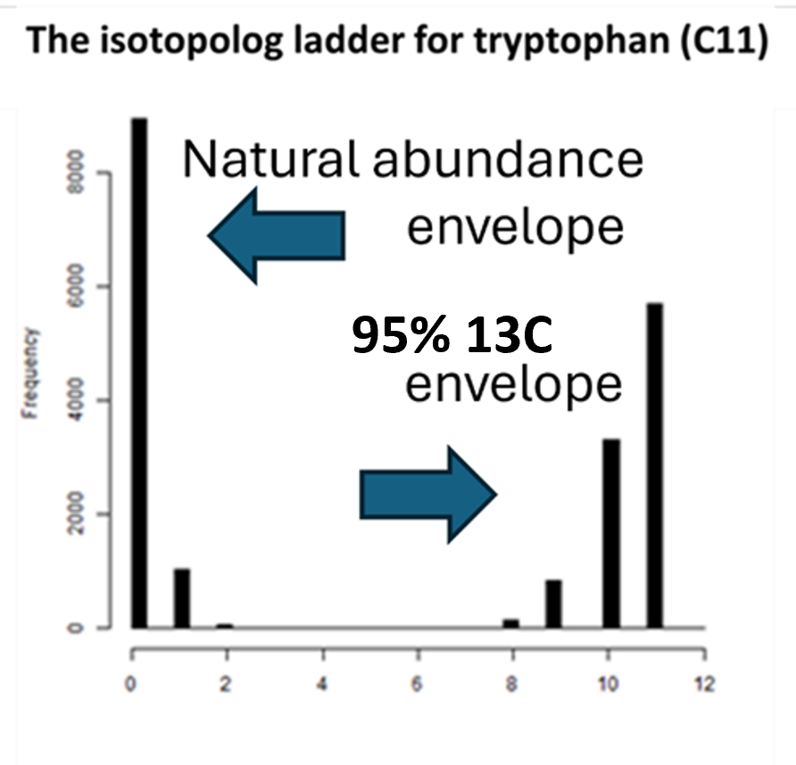
Isotopolog patterns are isotopic envelopes
The ladder contains an equal concentration of molecules (1:1) from both sources:
the right (95% ¹³C) and left side (1.1% ¹³C natural abundance).
However, the molecules are distributed very differently.
The relative heights of each isotopolog peak in a ladder is determined by the isotopic balances of the source materials. The height of the peaks of isotopically defined compounds (enriched in a single element such as carbon) may be effectively calculated¹
In the case of tryptophan, the base peak is still the C13 monoisotopic peak and represents only about half molecules in the internal standard.
The height of the base peak is never indicative of concentration; rather the sum of all peaks from each collection must be considered.
The base peak for an IROA compound with more than 20 carbons will no longer be the C13 monoisotopic peak. Instead, depending on the number of carbons, it will become one of the lower mass isotopologs. This is because as the number of atoms in a molecule increases, the probability that the entire molecule contains at least one heavy isotope also increases.
1Calculated using the binomial expansion of the expression (12C% + 13C%)N - where N equals the number of carbons, and 12C% and 13C% equals the relative isotopic abundance.
This is technically a polynomial expansion in which the dominance of carbon makes the remaining terms less important.
Notes:
Now, if we go back to the concept of isotopic ladders,
In our mass spec workflow, there are always contributions from two different sources in our analytical sample, usually an analyte from an experimental sample (natural abundance) , the left side set of peaks shown here, and an internal standard spiked into the sample (labeled at 95% C13) seen as the right side set of peaks. The peaks from both sources will superimpose onto the same ladder.
What I am showing you here is a ladder for tryptophan that is made up of 2 collections of peaks (NA and 95%), both having an equal concentration of molecules. Even though there is an equal concentration of molecules you can see that they are distributed among the peaks very differently.
The relative heights of each isotopolog peak in a ladder is determined by the isotopic balances of the source materials. And these heights are easily calculated.
Importantly the height of the base peak is never indicative of concentration, but rather all peaks from each contribution must be summed.

Slide 7

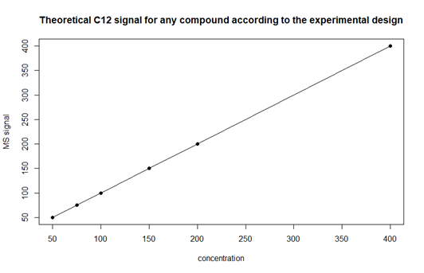
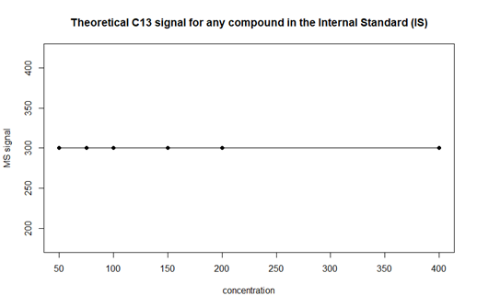
Suppression-correction and Normalization
A large homogeneous single extract of plasma was made.
Varying quantities of the extract were delivered as triplicate individual samples.
Samples were dried and resolvated in a constant volume of the IROA-IS.
Samples were MS analyzed, the IROA and corresponding NA peaks examined.
Mahmud et al. Ion suppression correction and normalization for non-targeted metabolomics. Nat Commun 2025 16, 1347
Notes:
To prove the existence, and ability to correct for suppression and then use suppression-corrected
values to normalize samples we devised the following experiment:
A large homogeneous single extract of plasma was made.
From the extract, triplicate individual samples of varying quantities were made: 50 ul, 75 ul, 150, 200 and 400 ul aliquots
Samples were dried down and then resolvated in a constant volume of the IROA-IS.
Samples were then analyzed by mass spectrometry and the IROA peaks and corresponding natural abundance peaks were then examined.

Slide 8

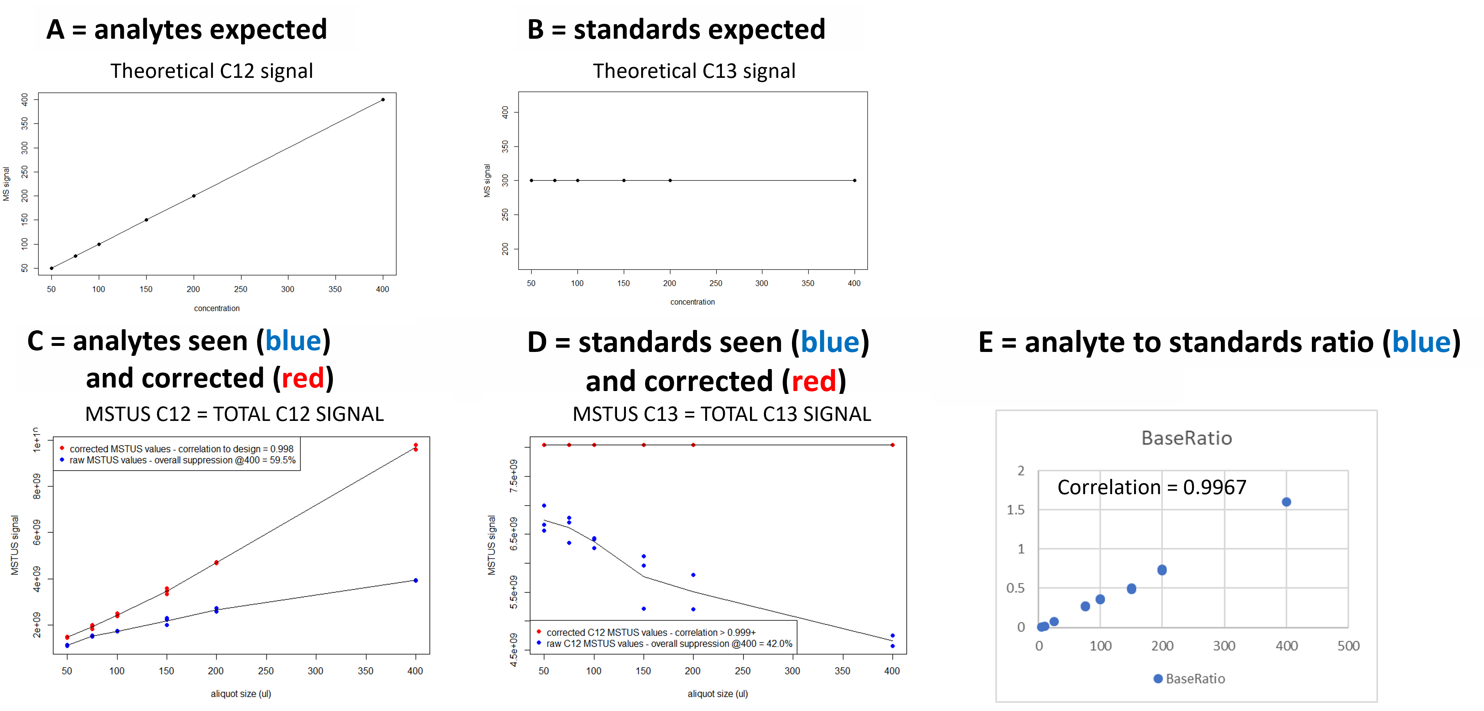
Suppression (expected vs. observed)
Mahmud et al. Ion suppression correction and normalization for non-targeted metabolomics. Nat Commun 2025 16, 1347
Notes:
First of all, you will see reference to MSTUS values – MS Total Usable Signal – meaning we only used signals from known compounds.
Graphed here are the MSTUS values of each injection.
In plotting the MS signals of the increasing plasma aliquots, like a standard curve, we would expect to see a graph similar to what is seen in A, but we what we got is seen below that in graph C, in blue. Similarly, when we added the IROA internal standard into each sample at the same concentration, we expected to see a straight horizontal line as shown in graph (B), but what we see is in D (shown in blue).
In this experiment a large portion of the error is concentration dependent and therefore largely driven by ion suppression. A quick observation of the blue lines seen in both C and D suggests that the suppression seen in the natural abundance samples and internal standards are similar, and graph E, the C12/C13 ratio, proves that they are perfectly correlated.
So, if we know what the unsuppressed value was for every compound, we can correct the data that we saw in C (blue) to its suppression corrected values seen in C & D (red). It is important to note that that this correction is applied to each compound in each sample independently, i.e., suppression-correction is compound specific because the suppressibility is a function of chemical structure.

Slide 9
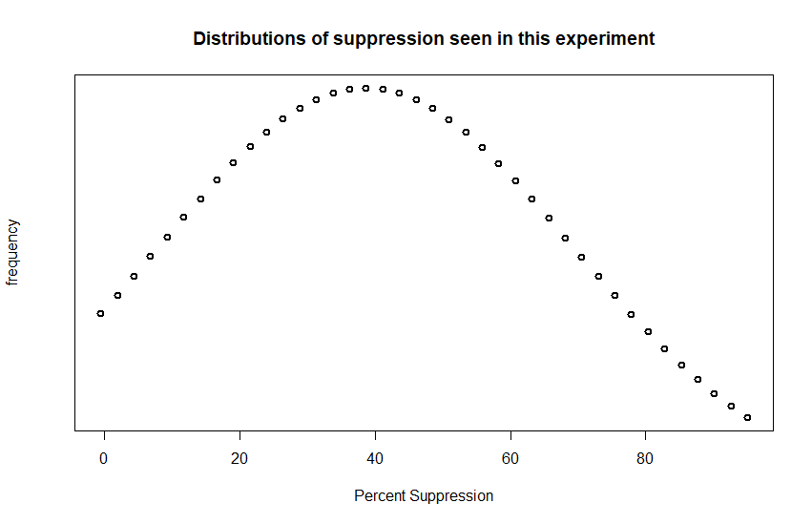
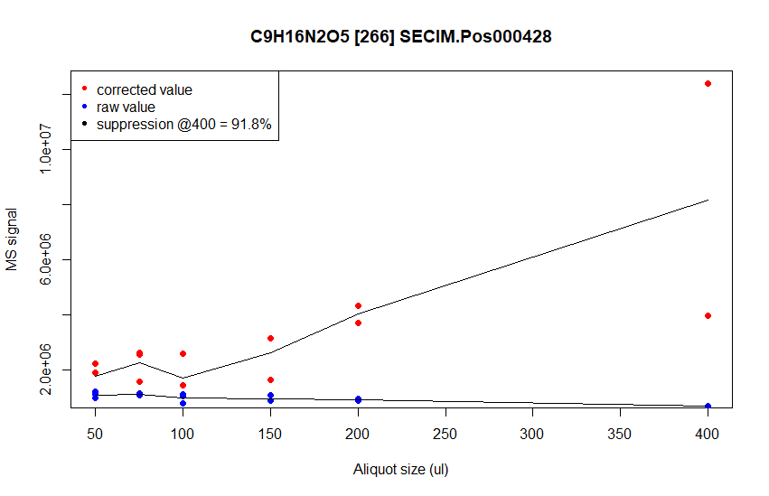
All Compounds are Suppressed
Very heavily suppressed compounds have a
negative correlation to concentration.
All compounds showed some level of
suppression. The range of suppression
ranged from 6% to 92%.
Mahmud et al. Ion suppression correction and normalization for non-targeted metabolomics. Nat Commun 2025 16, 1347
Notes:
In this slide we are looking at the distribution of average suppression among all the MSTUS compounds in the samples in the most concentrated sample (approximately 2 times “normal” injection volume). As you can see, the average compound is subjected to a 40% suppression, within a range of <5% to >85% suppression. In the graph on the right, you can see that above 80% suppression the AUCs are in fact negatively correlated to their aliquot size.

Slide 10
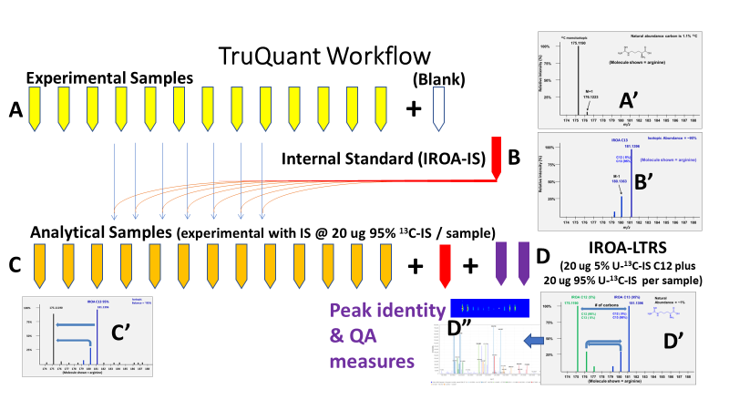
The TruQuant Workflow
(Fully automated with ClusterFinder)
Notes:
Ok now that we have our tools, isotopic standards and software I will introduce the workflow.
The natural abundance experimental samples (A) are spiked with internal Standard (B), you can see a representation of their corresponding chromatographic signatures in A’ and B’. The experimental samples with IS are analyzed in the same sample set with the LTRS (it’s chromatographic signature is seen in D’) which is injected about every 10 samples.
During LC-MS, a metabolite is often seen multiple times. Most frequently this due to in-source fragmentation. Post-source fragmentation also occurs such as when using SWATH and other MSMS techniques.

Slide 11

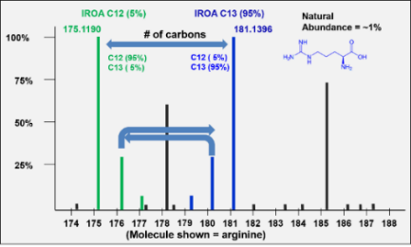

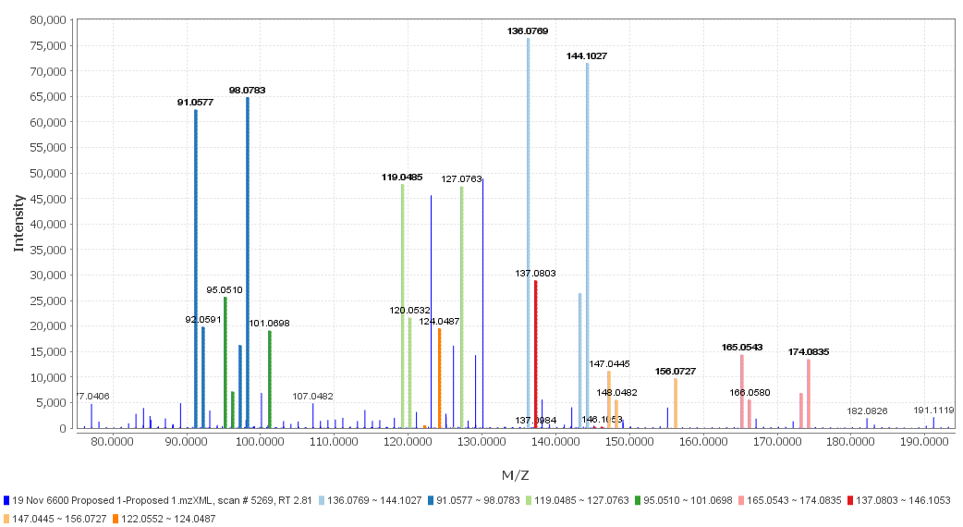
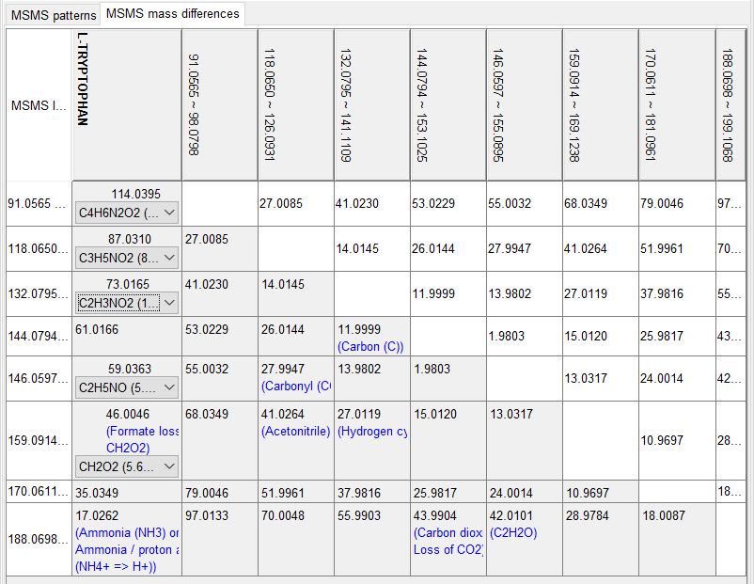
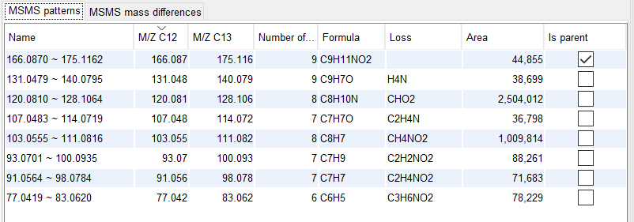
Compound Identification in the IROA-LTRS
The basic chemical attributes lends support to the mass spectral characteristics collected next.
The triply redundant information in ms
provides formula, retention time, and all of the basic spectral features needed to find the same features in experimental samples.
IROA-LTRS
(1:1 mixture of 5% C13 plus
95% C13 results in balanced symmetrical, uniquely identifiable peaks)
In IROA Ion Mobility the IROA IM peaks retain their patterns perfectly because all IROA isotopomers share the same CCS.
D’
D5’
UV, IR, or other
Spectrometer
D
D1’
Chromatographic separation
(LC, HPLC, UPLC, etc.)
All adducts and fragments
have the identical peak pattern of their parent peak.
Mass Spectrometer
Primary Scan
Mass Spectrometer
Secondary stage
D4’
D2’
D3’
IROA msms fragmentation, such as SWATH, the IROA peaks retain their patterns (D2’) because wide windows are used.
Since all fragments retain their IROA character, their formulae (D3’) and the relationships between them (D4’) are determinable.
Notes:
Peak identification gets a whole lot easier because IROA fragments retain the same pattern as their parent peaks, and similarly through Ion Mobility where all the IROA-peaks share a common collisional cross-section.
The ClusterFinder peak correlation analysis tool associates both in-source and post-source fragmentation sets, greatly aiding in peak identification and identification of peaks that would otherwise be unknowns.
As I mentioned before, the monoisotopic mass and the exact number of carbons in the molecule are known for all IROA peaks, and while this is sufficient to provide a unique molecular formula we know that about 48% of molecular formula are shared by another isobaric compound.
So, if in addition to the molecular formula for each IROA peak, we add CCS from IM, Fragmentation data, or any other physical characteristic of each compound in the LTRS then these become unique identifiers for each compound. This information is added to the LTRS “dictionary” in the software and becomes the basis of reproducible accurate identification and quantitation.

Slide 12

Suppression Correction Summary
In metabolomics accurate quantitation requires trusting that the peak area under the curve is proportional to the concentration.
We know this is not correct and we use the TruQuant workflow to correct the data.
Metabolites in the IROA Internal Standard are spiked into samples at constant concentrations, and the loss of IROA signals due to ion suppression in each sample can be determined.
This information is used to correct for the loss of corresponding natural abundance (NA) signals because the IROA and NA metabolite peaks are generated and analyzed in the same environment and suffer identical suppression.
Notes:
Another quick summary. We know that the peak area under the curve is not proportional to the concentration.
Because the NA and IROA peaks suffer identical suppression as they are generated and analyzed in the same environment, if we use internal standards at constant concentrations and know their loss, we can use this information to correct for the loss of corresponding NA signals.

Slide 13
Dual MTSUS Normalization
In metabolomics error is introduced during sample preparation when sample size and extraction processes vary. TruQuant corrects this using Dual MSTUS normalization.
MSTUS normalization determines a total useful signal value for each sample by excluding all clearly non-relevant signals and then sums the remaining data.
Because it uses two MSTUS values, i.e. peaks that are found in both the original natural abundance sample ([MSTUS-12C]) and those peaks found in the IROA-IS sample ([MSTUS-13C]), we refer to this as a “Dual MSTUS algorithm”.
The IROA-IS ¹³C values for each metabolite should be equal across all samples, so we adjust each MSTUS-12C value to the corresponding MSTUS-13C value to normalize all ¹²C signals to improve precision and relative quantitation across variable conditions.
Notes:
Now for the normalization.
Since we have two different sets of metabolites (the experimental sample and the IS) in each physical sample and we are using only known compounds, we call this a “Dual MSTUS” normalization. We calculate the MSTUS values for each (C12 and C13) and adjust them, so they are normalized to the value of the C13 Internal Standard.
We have learned that a MSTUS normalization results in more stringent normalization than current methods. This is presumably because we first removed instrumentation- derived error in the MSTUS raw data prior to normalizing.

Slide 14
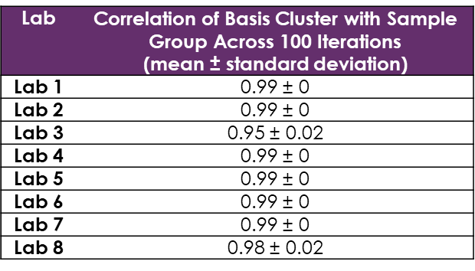
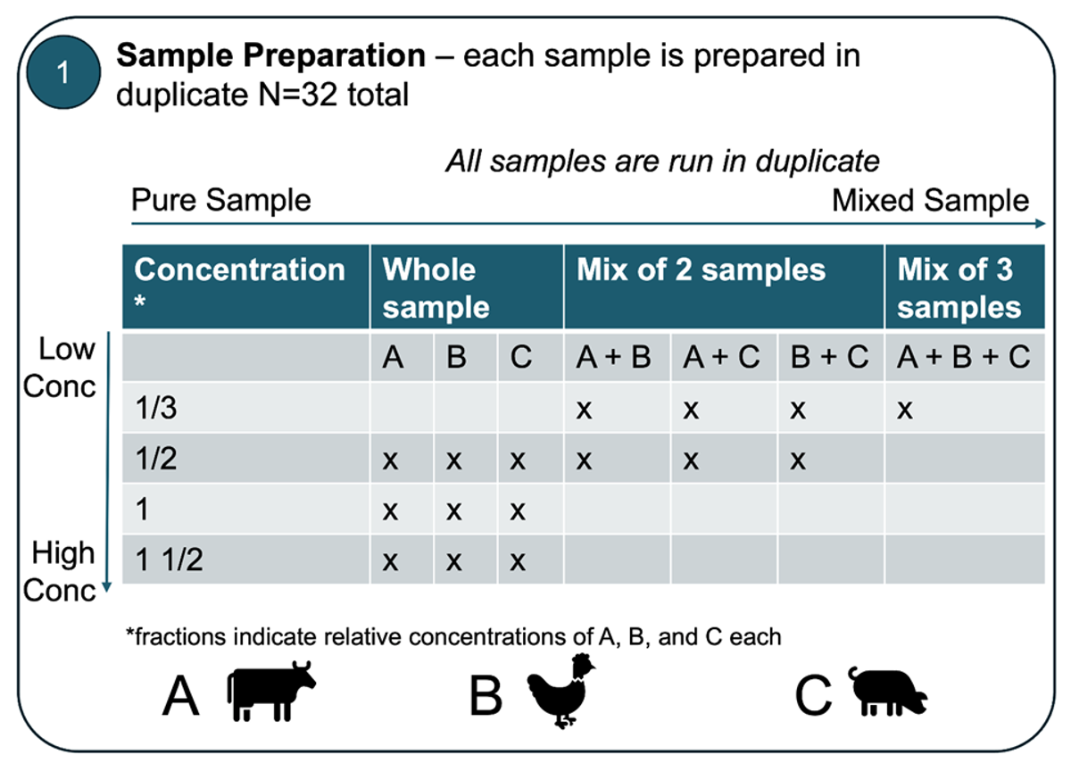
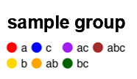
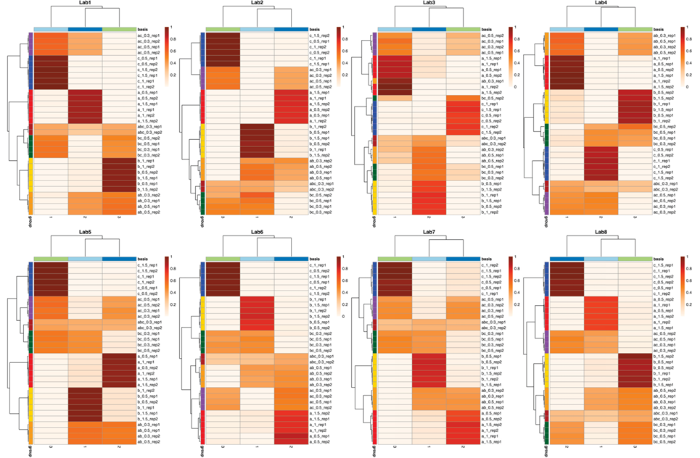
If 8 labs ran the same samples using TruQuant internal standards, how reproducible are the results?
Notes:
Project run by NIH/NCATS it is in manuscript and was to have been submitted in early October.

Slide 15
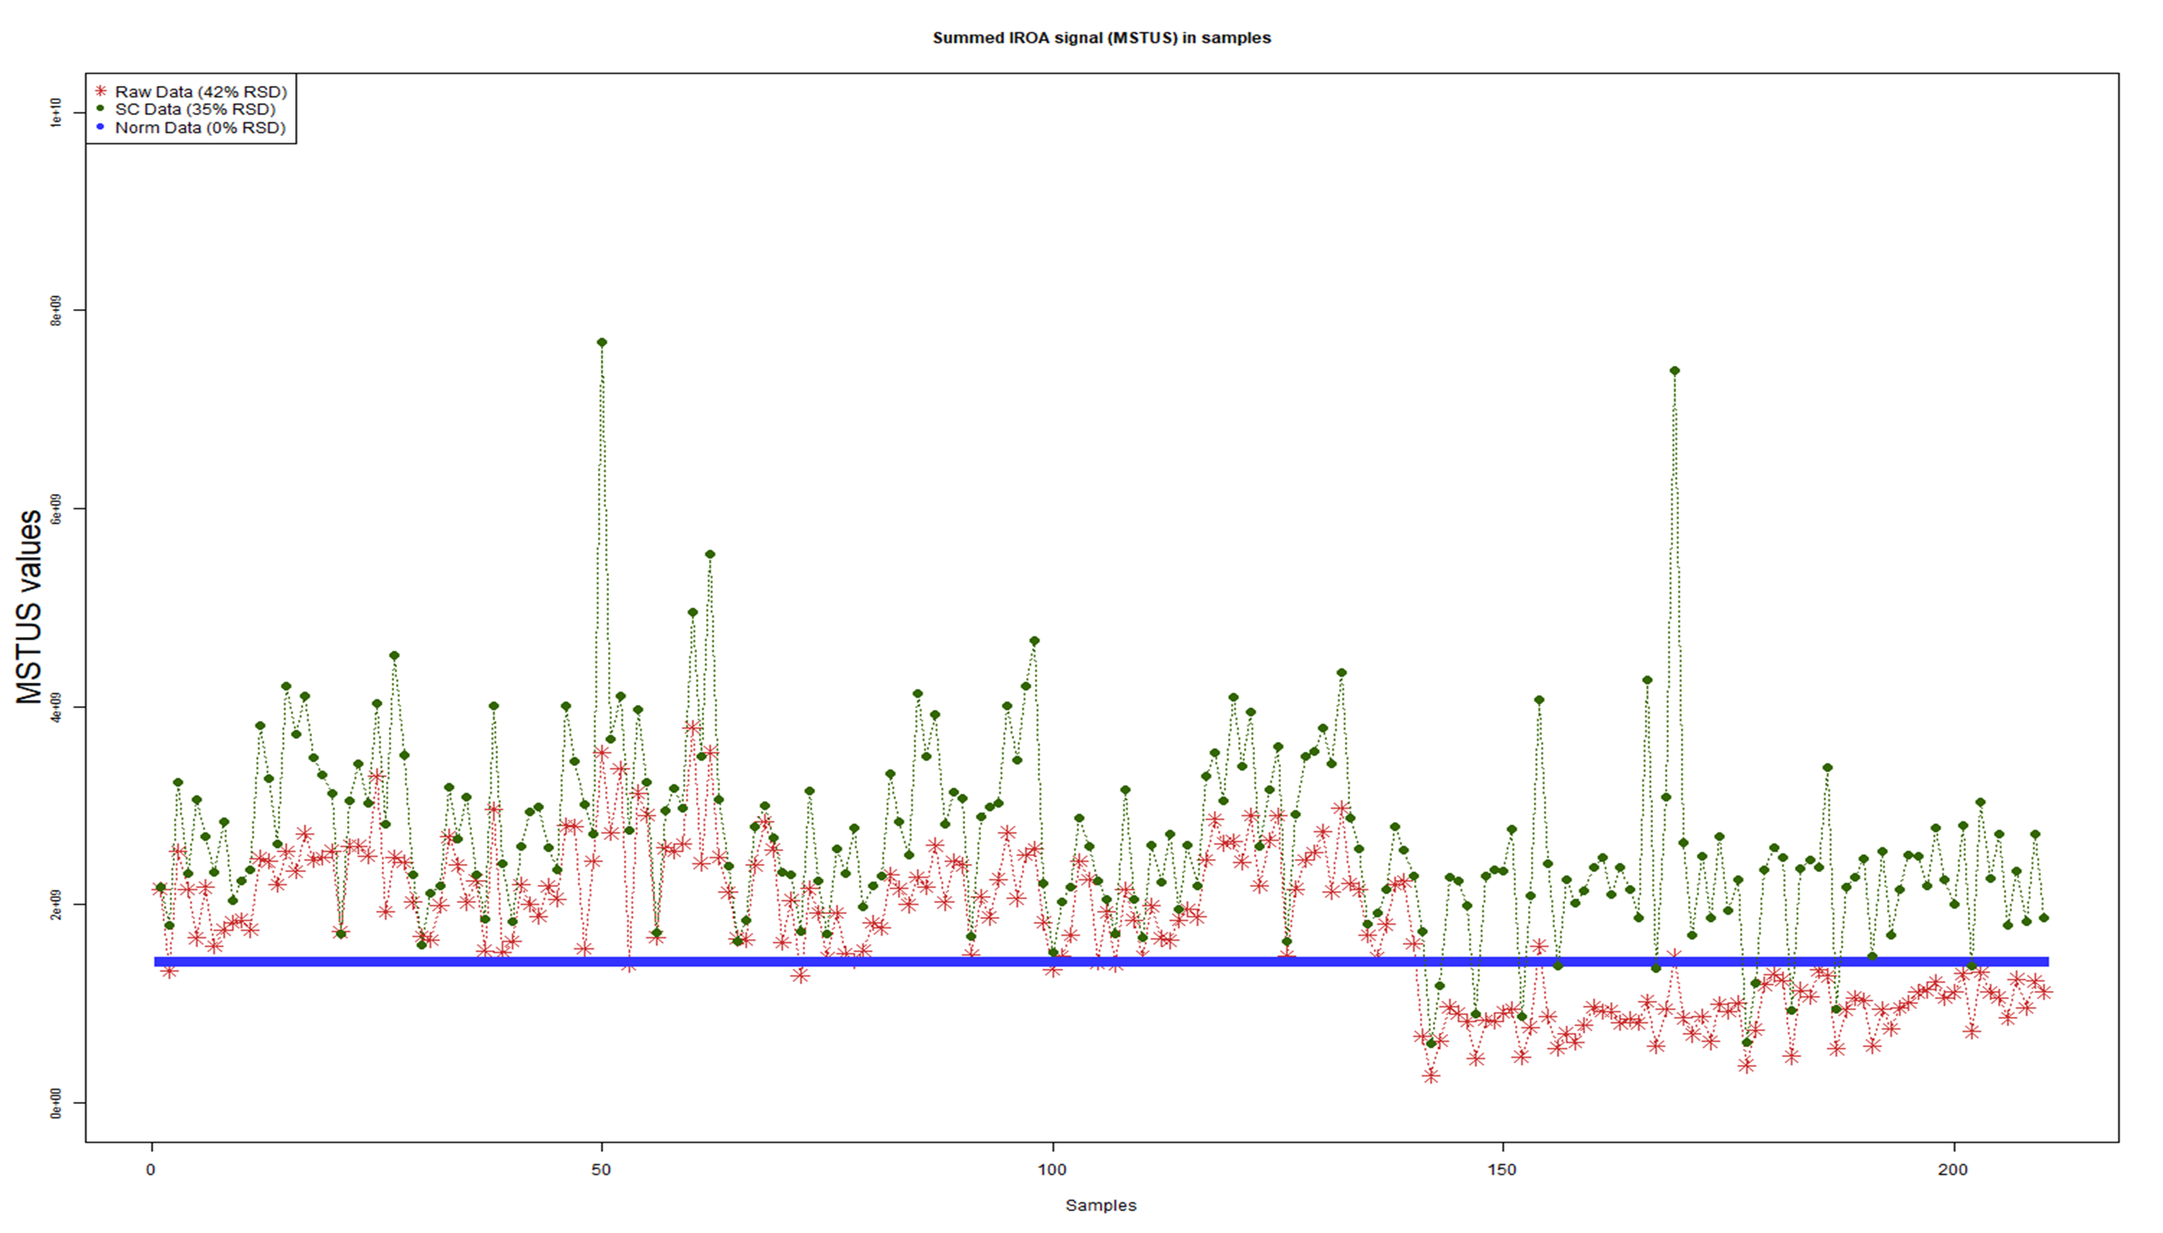


Normalization extended over multi-batch analyses
Batch 1
Batch 2
Batch 3
Batch 4
Batch 5
Batch 6
Notes:
Manuscript submitted to Analytical Chemistry. Currently revising after reviewers comments supported acceptance.

Slide 16



IROA Workflow Manual
send questions to:
chris@iroatech.com
MD Anderson Cancer Center
Nature publication

